Slide 1
Early Career Guidance CE 4200 Professional Engineering Practice Issues
SPRING 2022 Semester
William D. Lawson, P.E., Ph.D.

Slide 2
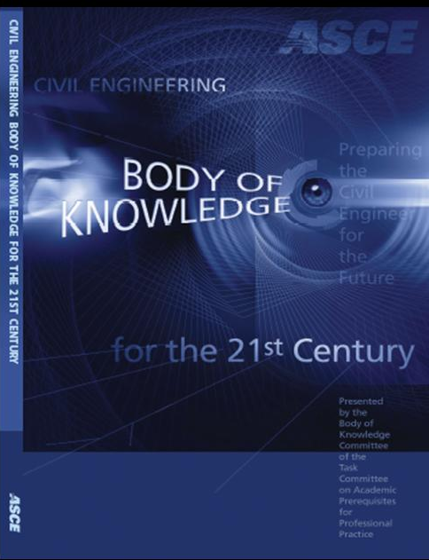
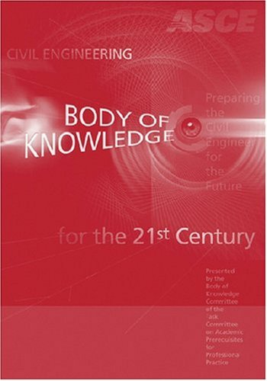
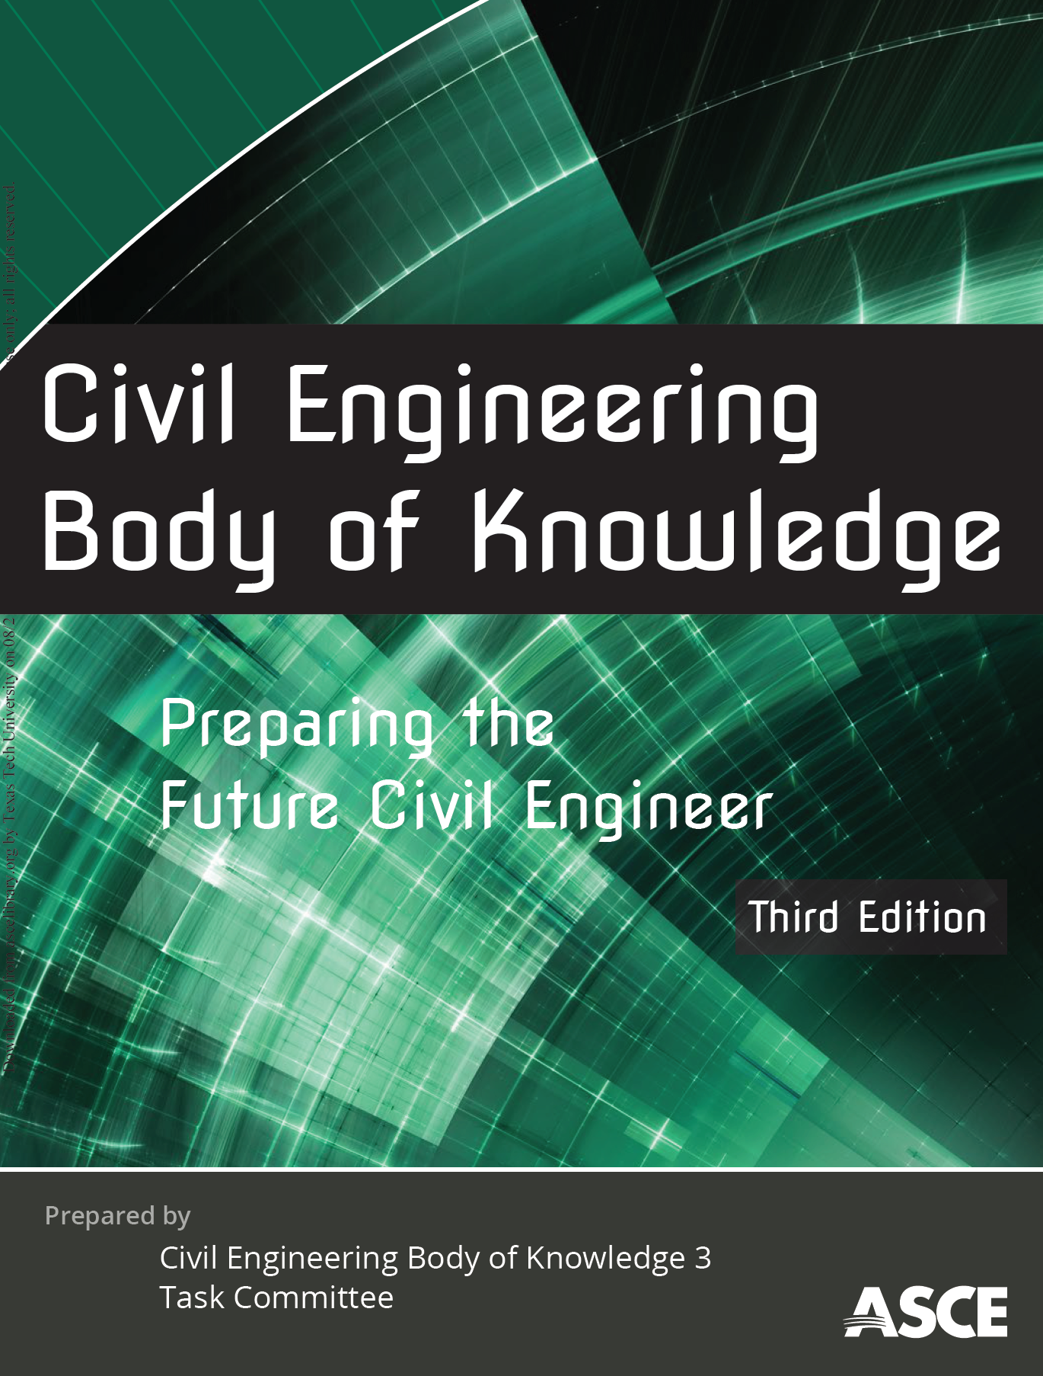
BASIC SOURCE MATERIAL FOR THESE LECTURE NOTES
BOK1 (2004)
BOK2 (2008)
BOK3 (2020)

Slide 3
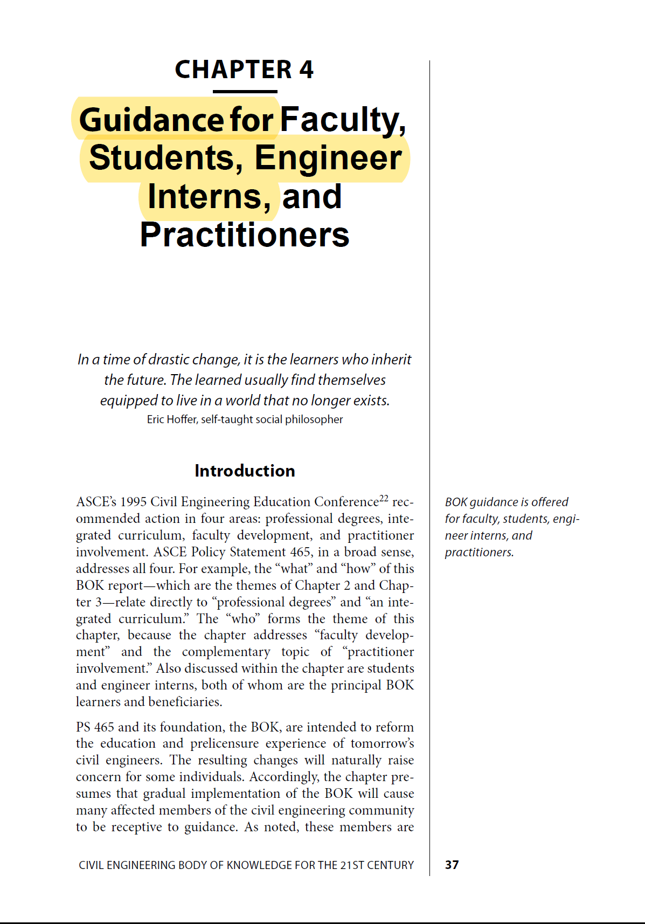
BOK2E

Slide 4
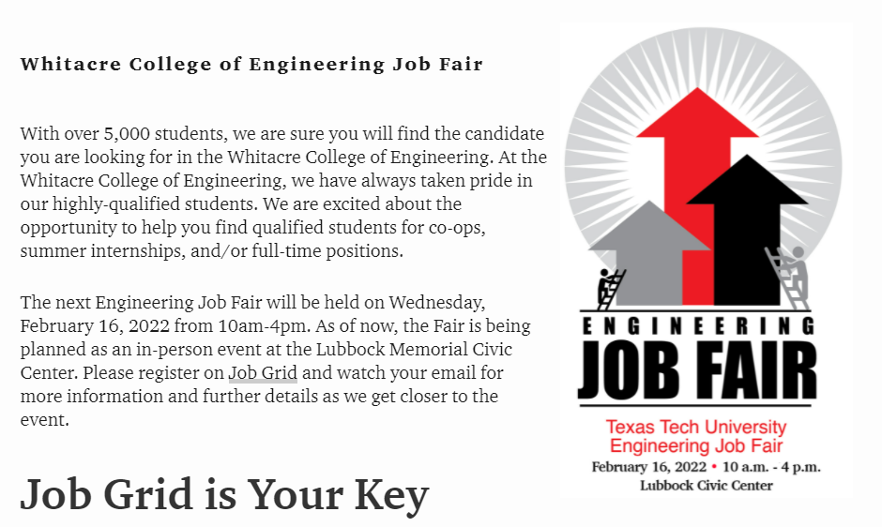
WCOE JOB FAIR WED, 16 FEB 2022

Slide 5

A Common Question from CE Senior Students

Slide 6
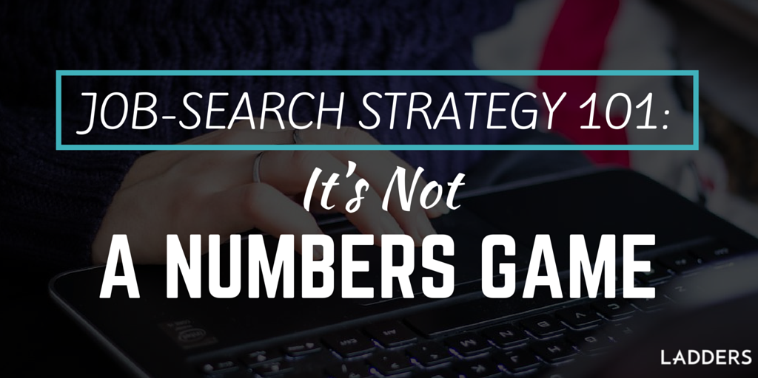

Slide 7


The top ten happiest life moments
Birth of a first child (12.3% of vote)
Wedding day (11.5%)
Birth of grandchildren (10%)
Birth of another child (8.5%)
Day of retirement (7.4%)
Moving into a new home (6.7%)
Seeing your child's first steps (5.5%)
Hearing your child’s first words (5.4%)
Meeting the person of your dreams (4.5%)
First kiss with the person you love (4.4%)
source: The Huffington Post (2015)

Slide 8
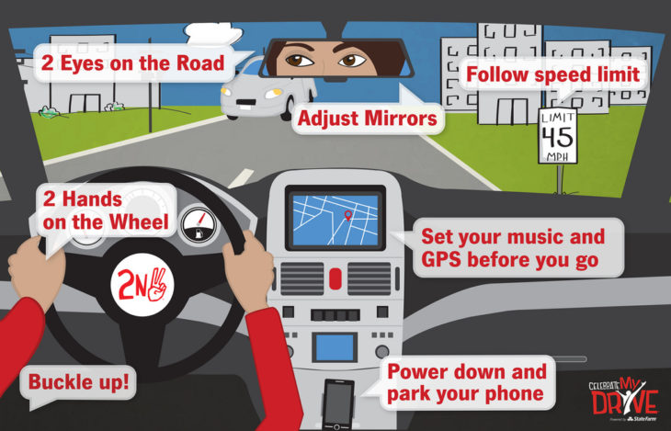
A Course in Defensive Driving

Slide 9
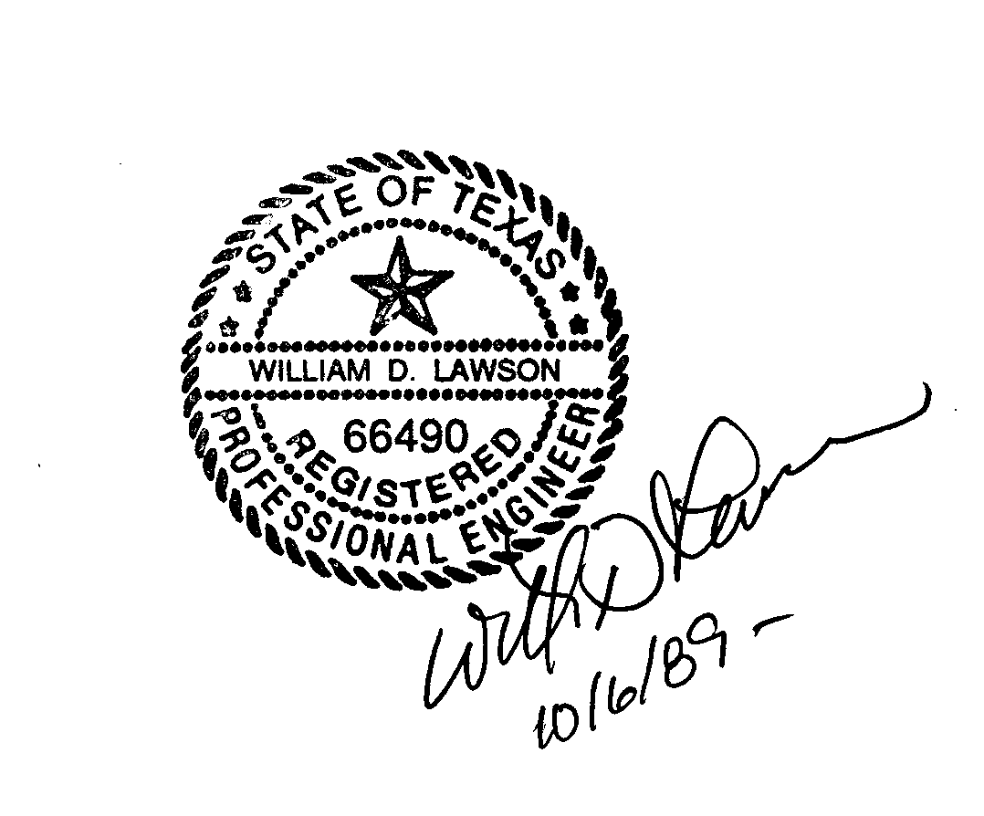
The top ten happiest life moments
Pursuing (and achieving) a personal life goal

Slide 10
Outline for Today’s Lecture
Not a job, but a fit
Not what others want for you, but what you want for yourself
Not just salary, it’s about personal satisfaction

Slide 11
CE 4200 Professional Engineering Practice Issues
YOUR PERSONAL CAREER PLAN

Slide 12


Slide 13
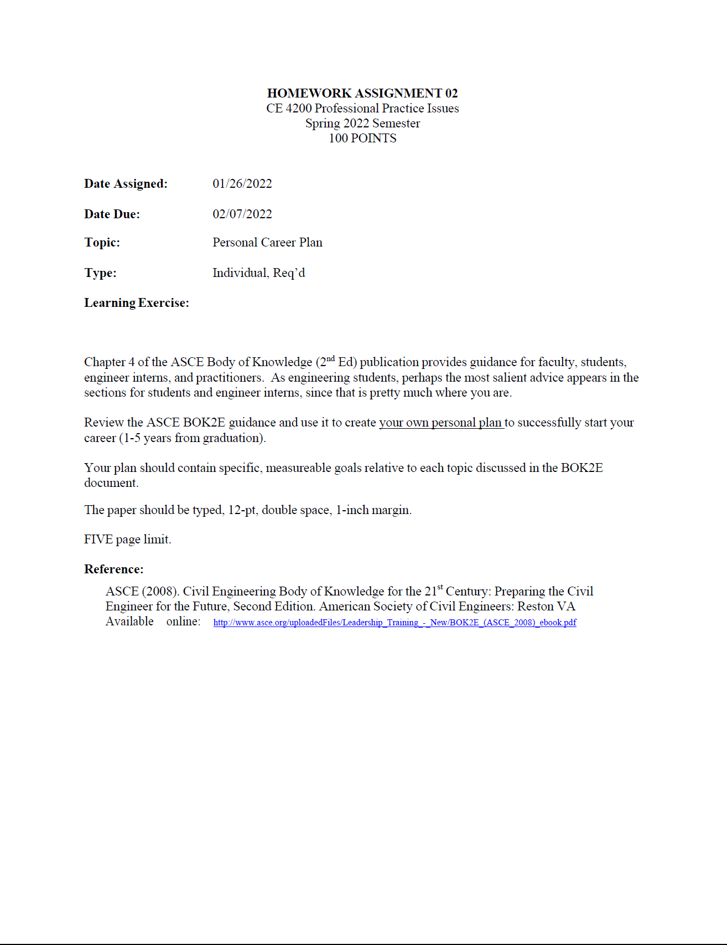

Slide 14
Illustration from my past
Series of events leading to writing “lifetime goals”
Professor’s daughter’s school event
Conversation with a friend
Realization… it had been a while since I thought about my goals
What I did
I took some time
Wrote out a series “lifetime goals”

Slide 15

Some observations about goals

Slide 16
Some Suggestions
TOPICS |  | TIME ASPECT
Professional |  | Immediate
Educational |  | 2-3 years
Financial |  | 5-6 years
Spiritual |  | 10-15 years
Personal |  | Revisit

Slide 17
Be Sure to Check out CEBOK2 Chapter 4

Slide 18
CE 4200 Professional Engineering Practice Issues
Not a Job, but a “fit”

Slide 19

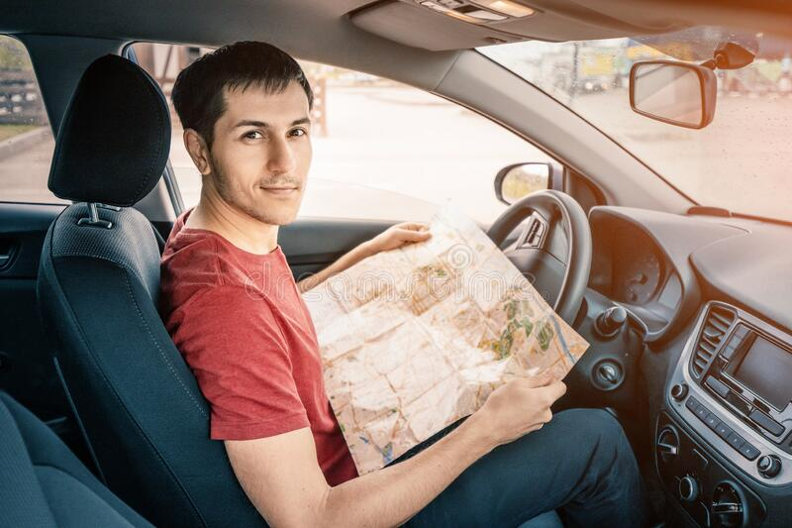
Riding vs. Driving
Compare and contrast:
How are “riding” and “driving” alike?
How are they different?

Slide 20
CE 4200 Professional Engineering Practice Issues
Not what others want for you, but what you want for yourself

Slide 21
The job hunting difference
WITH Goals |  | Without Goals
You know what you want |  | You haven’t thought about it
You evaluate opportunities |  | You look for a job
You offer clear responses |  | You have vague notions
You seek specific information |  | You never get this far
You make a decision that, ALL things considered, is best for you and your life |  | You get a job, maybe (hopefully)

Slide 22


Knight and Day (2010)

Slide 23
The top ten happiest life moments
The top five BIGGEST REGRETS
Choosing the wrong career
Not furthering education
Not traveling enough
Getting divorced
Getting married too soon
source: The Huffington Post (2015)

Slide 24
CE 4200 Professional Engineering Practice Issues
Not just salary, it’s about personal satisfaction

Slide 25
Some Suggestions
Identify the specific job aspects that matter to you
Identify “weights” for each aspect
Create subcategories
Be as detailed as you can be
Carefully think about each opportunity
Do a side-by-side evaluation
Assign point values
Add up the values (a spreadsheet comes to mind)

Slide 26

The Outcome…
“All things considered…”

Slide 27
CE 4200 Professional Engineering Practice Issues
QUESTIONS?

